Slide 1
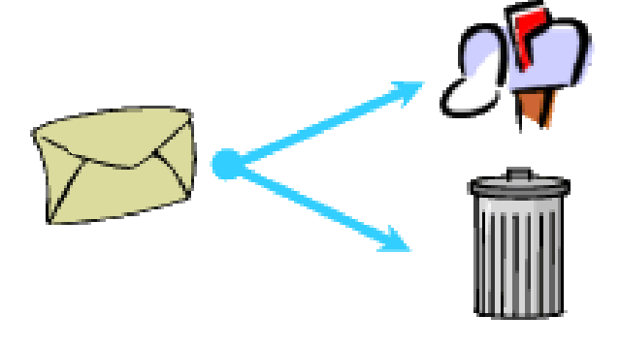
Naïve Bayes for Text Classification: Spam Detection
DONE BY:
Mihir Lakhani (PES2201800071)
Alex Stuart
(PES2201800360)

Slide 2
INTRODUCTION
Spam e-mails can be not only annoying but also dangerous to
consumers.
Spam e-mails can be defined as :
Anonymity
Mass Mailings
Unsolicited:
Spam e-mail are message randomly sent to multiple addressees by all sorts of groups, but mostly lazy advertisers and criminals who wish to lead you to phishing sites.

Slide 3
NAÏVE BAYS CLASSIFIER
Simple probabilistic classifier that calculates a set of probabilities by counting the frequency and combination of values in a given dataset.
Represent as a vector of feature values.
It is very useful to classify the e-mails properly
The precision and recall of this method is known to be very effective

Slide 4
PROBLEM STATEMENT
Unwanted e-mails irritating internet connection
Critical e-mail message are missed and / or delayed.
Millions of compromised computers
Billions of dollars lost worldwide
Identity theft
Spam can crash mail servers and fill up hard drives

Slide 5
OBJECTIVE
The objective of identification of Spam e-mails are :
To give knowledge to the user about the fake e-mails and relevant e-mails
To classify that mail spam or not.

Slide 6
SCOPE OF THE PROJECT:
It provides sensitivity to the client and adapts well to the
future spam techniques.
It considers a complete message instead of single words with respect to its organization.
It increases Security and Control.
It reduces IT Administration Costs.
It also reduce Network Resource Costs.

Slide 7
FLOWCHART OF THE PROJECT

Slide 8
DOCUMENT PREPROCESSING
Tokenization
Tokenization is the process of breaking a stream of text up into words, phrases, symbols, or other meaningful elements called tokens.
The list of tokens becomes input for further processing such as
parsing or text mining.

Slide 9
LEMMATIZATION
Lemmatization in linguistics, is the process of grouping together the different inflected forms of a word so they can be analysed as a single item.
In computational linguistics, lemmatisation is the algorithmic
process of determining the lemma for a given word.

Slide 10
REMOVAL OF STOP WORD
Sometimes, the extremely common word which would appear to be of very little value in helping select documents matching user need are excluded from the vocabulary entirely.

Slide 11
REQUIREMENT ANALYSIS
Functional Requirement:
To classify the e-mails which is done by first taking out the feature vector extraction which involves first taking out whether the word is a spam or not.
Non-Functional Requirement:
Ensures high availability of email data here datasets. User should get the result as fast as possible.
It should be easy to use i.e., user is just required to type the words and click then the result is displayed or user is just required to enter a pair of reasonable sentence.

Slide 12
TESTING
We tested the datasets and found out which e-mail is spam
and which mail is non spam indicated as 0 and 1 respectively.
We calculated the feature vector to know whether it is spam or non-spam
Using that feature vector Naïve Bayes Algorithm works by comparing the trained data to test the data

Slide 13
DATASET
Dataset is a collection of data or related information that is
composed for separate elements.
A collection of dataset for e-mail spam contains spam and non-spam messages.

Slide 14
OUTPUT
Any external email can be detected and classified as spam e-
mail. So the users will be aware of such email.
Mails are classified into spam and non spam.
From the classified data we have calculated the accuracy as
98.77 %

Slide 15
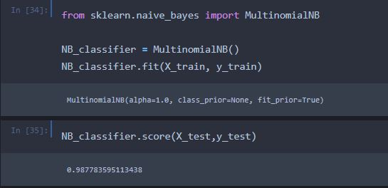
OUTPUT-1 (Score of the model on test data)

Slide 16
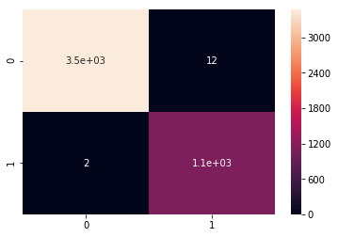
OUTPUT-2 (Confusion matrix of y_train and y_pred_train)

Slide 17
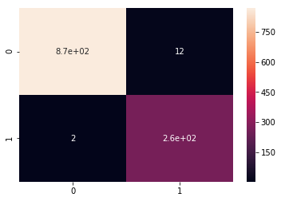
OUTPUT-3 (Confusion matrix of y_test and y_pred_test)

Slide 18
CONCLUSION
We are able to classify the emails as spam or non-spam. With high number of emails lots if people using the system it will be difficult to handle all possible mails as our project deals with only limited amount of corpus.

Slide 19
REFERENCES
Email Spam Classification using Neighbor Probability based Naïve Bayes Algorithm. https://ieeexplore.ieee.org/document/8418565
Spam Filtering using Association Rules and NaIve Bayes Classifier. https://ieeexplore.ieee.org/document/7489926
A Support Vector Machine based Naive Bayes Algorithm for Spam Filtering. https://ieeexplore.ieee.org/document/7820655

Slide 20
Thank You

